Slide 1
Mayor Pro-Tem Chad West
NOCUPP Meeting
Tuesday, April 26, 2022

Slide 2
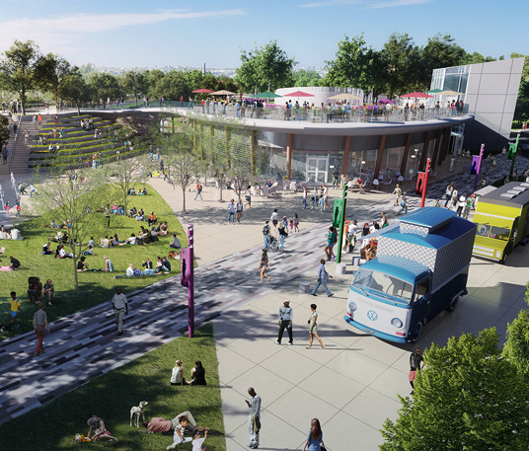
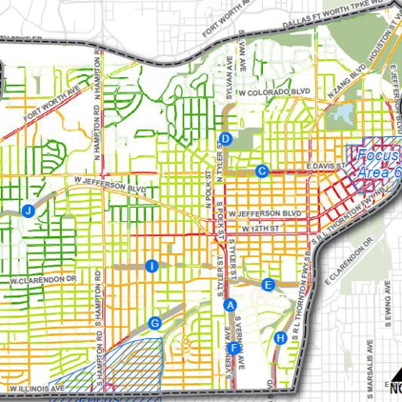
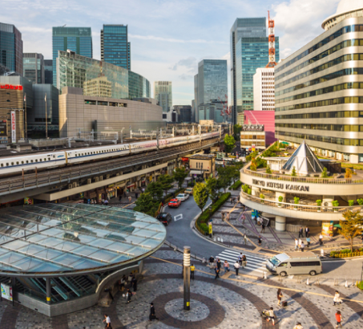
Table of Contents
Vision Zero Plan
Sidewalk Master Plan
Trail Network Status
Jefferson Blvd
Pedestrian Islands

Slide 3
Vision Zero Action Plan
Dallas City Council January 5, 2022
Ghassan “Gus” Khankarli, Ph.D. P.E.,
Director, Department of Transportation
Kathryn Rush, AICP, Chief Planner Department of Transportation

Slide 4
Background
City Council Vision Zero Resolution 19-1583
Committed the City to a goal of ZERO traffic fatalities and a 50% reduction in severe injuries by 2030.
Directed the City Manager to:
‒ Develop a Vision Zero Action Plan by December 2021
‒ Convene a Vision Zero Task Force that will collaborate with city departments on the development of a Vision Zero Action Plan
‒ Direct city departments to participate in Vision Zero Action Plan development, implementation, and evaluation
4

Slide 5
Vision Zero Action Plan Development
Best Practice Solutions Research
Existing Programs & Practices Review
Draft Recomme- ndations
Draft and Finalize Action Plan
Project
Initiation
Crash Data
Analysis
VZ
Task Force
VZ
Task Force
VZ Sub- Commit- tees
VZ
Task Force
Council Briefing
TRNI
Briefing
Public Input Phase 1
TRNI
Briefing
WE ARE HERE
Public Input Phase 1 (Summer 2021)
Public survey and interactive comment map
1,692 survey responses
Public Input Phase 2
Public Input Phase 2 (Fall 2021)
Two virtual public meetings.
Online survey closed December 3rd.
921 survey responses.

Slide 6
Vision Zero Action Plan Development
Vision Zero Task Force
City Departments:
Transportation
Public Works
Police
Fire-Rescue
Data Analytics
Budget Office
External Agencies:
Dallas County Sheriff’s
Office
Dallas County Health
and Human Services
TxDOT
NCTCOG
Baylor University Medical Center
Parkland Injury Prevention Center
Children’s Medical
Center
Mothers Against Drunk Driving
AARP
BikeDFW
Vision Zero
Task Force
Engineering
Sub-committee
Enforcement Education
Sub-committe•e _{Da}Su_{ll}b_{a}-c_{s}om_{IS}m_{D}ittee
6

Slide 7
The State of Traffic Safety in Dallas
Dallas has the second highest traffic fatality rate among the 15 most populous cities in the U.S.
(Traffic deaths per 100,000 people; 5-year average rate from 2015-2019)
A traffic fatality is
1.27 times more likely to occur in Dallas than in Fort
Worth.
1. | Jacksonville, FL | 15.79
2. | Dallas, TX | 14.11
3. | Phoenix, AZ | 13.71
4. | Fort Worth, TX | 10.84
5. | San Antonio, TX | 10.53
6. | Houston, TX | 10.07
7. | Austin, TX | 9.08
8. | Columbus, OH | 7.02
9. | Los Angeles, CA | 6.71
10. | San Diego, CA | 6.34
11. | Philadelphia, PA | 6.09
12. | San Jose, CA | 6.00
13. | Chicago, IL | 4.90
14. | San Francisco, CA | 3.52
15. | New York, NY | 2.56
National Rate |  | 11.22
Source: National Highway Traffic Safety Administration, Annual Traffic Safety Facts – 2015, 2016, 2017, 2018, 2019.
7

Slide 8
Focus Areas for the Action Plan
Topic Focus Areas
Pedestrian-Involved Crashes (36% of severe crashes)
Speeding/Unsafe Travel Speeds (19%)
Under the Influence (14%)
Not Using Proper Restraints (Seat Belt, Car Seat) (16%)
Left-Turn Crashes (10%)
Red Light Running (10%)
Distracted Driving (only 5% in crash data, but a top priority in the survey)

Slide 9
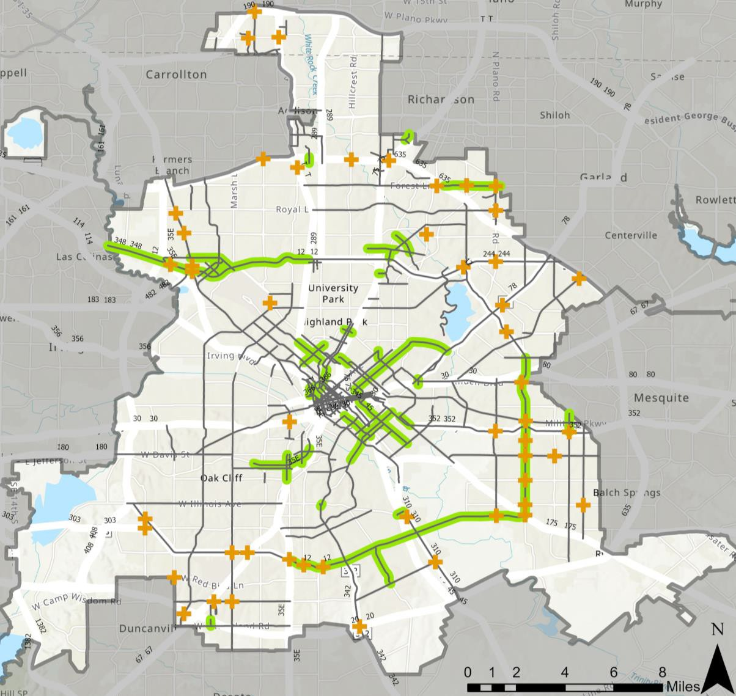
Focus Areas for the Action Plan
Geographic Focus Areas
High Injury Network (HIN): streets where a disproportionate number of severe crashes have occurred.
In Dallas, 8% of streets (non- freeways) account for 60% of severe crashes.
Of the roadways that account
for the remaining 40%:
15% of severe crashes were on other streets (non-freeways)
25% were on freeways
LEGEND
High Injury Network Top 50 Street Miles
Top 50 Intersections

Slide 10
Recommendations
Outline:
Overall Themes
Engineering
Enforcement
Education
Coordination & Legislation
Equity
Evaluation
Focused on 5-year timeframe. The Action Plan should be re-evaluated and updated after 5 years.

Slide 11
Update of the City’s Sidewalk Master Plan and Sidewalk Project Prioritization Process
City Council Briefing June 16, 2021
Robert M. Perez, Ph.D., Director Ali Hatefi, P.E., Assistant Director Efrain Trejo, Manager II Department of Public Works

Slide 12
What is it?
DALLAS SIDEWALK MASTER PLAN
A Plan to move Dallas forward in improving pedestrian usability
Process to identify impactful projects for staff
Visioning to take in feedback from public
Alignment with policy documents and other plans such as the ADA Transition Plan
Guidance for decision makers on budgeting and improvements

Slide 13
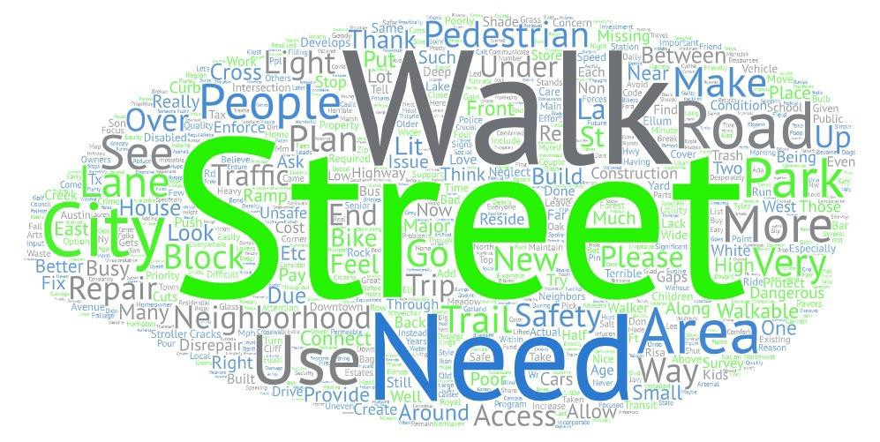
What we’ve heard
DALLAS SIDEWALK MASTER PLAN
Over 12,600 total visits to website
1,000 survey responses
Available in English and Spanish

Slide 14
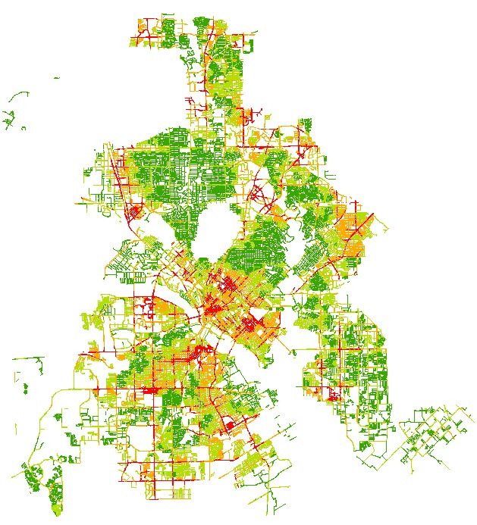
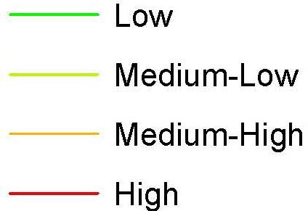
Prioritization Map
DALLAS SIDEWALK MASTER PLAN

Slide 15
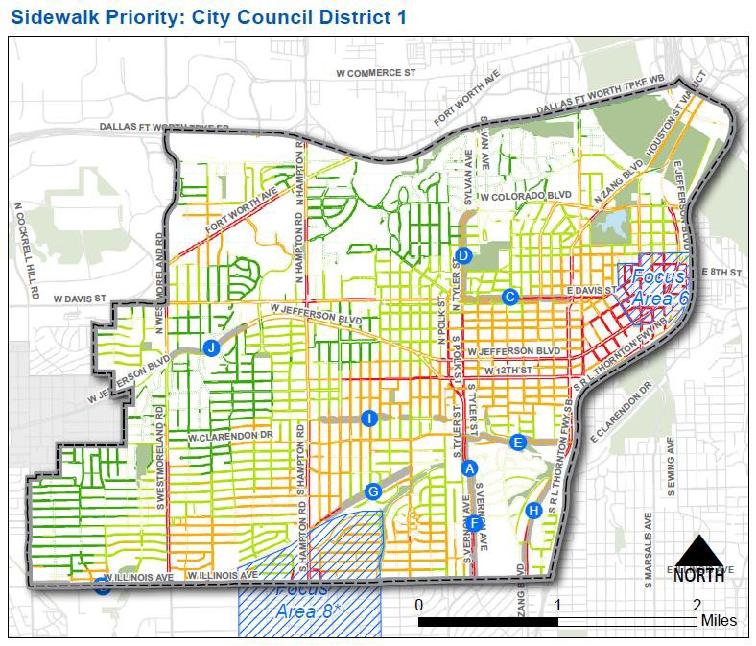
Council Specific
DALLAS SIDEWALK MASTER PLAN
Provides in-depth look into Council District
Expanded area based on neighborhood characteristics
Identification of major improvements

Slide 16
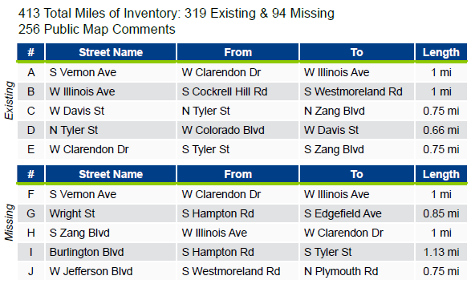
Council District 1
DALLAS SIDEWALK MASTER PLAN
Pertinent metrics identified
Incorporation of public feedback
Top 5 corridors/areas within district

Slide 17
Trail Network Status
Completed Trails:
Completed Trails
180.4 miles

Slide 18
Trail Network Status
Funded Trails:
45.0 miles
Completed Trails
Funded Trails

Slide 19
Trail Network Status
Unfunded Trails:
89.1 miles
Completed Trails
Funded Trails
Unfunded Trails

Slide 20
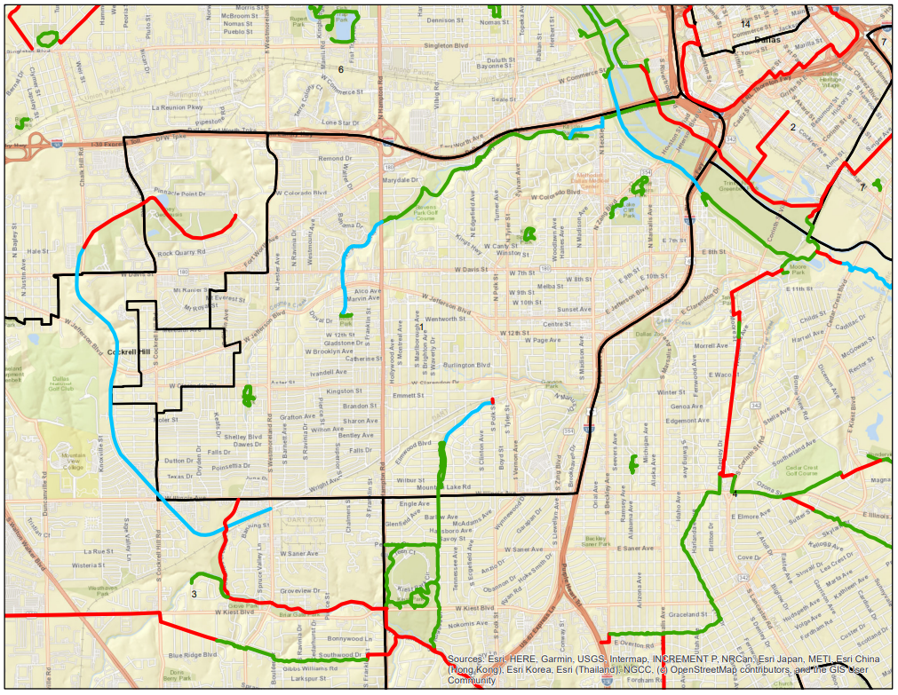
Trail Network Status
Coombs Creek Trail: 2024
Trinity Skyline Trail To be Determined
Coombs Creek Trail: 2023
Chalk Hill Trail
To be Determined
Elmwood Parkway Trail: 2022
Completed Trails
Funded Trails
Unfunded Trails

Slide 21
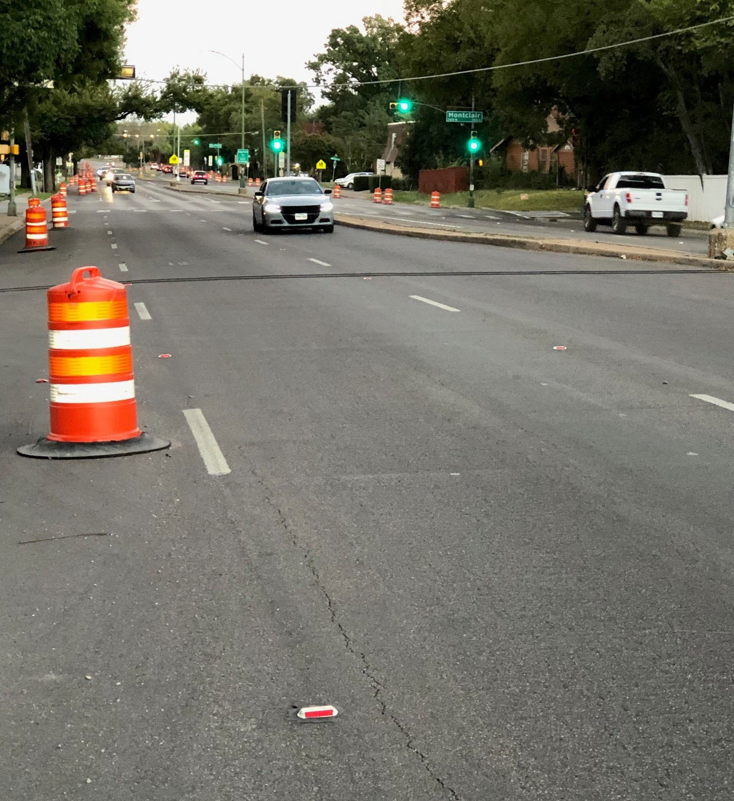
Jefferson
Boulevard Task Force
UPDATE FROM
JAN 20, 2022

Slide 22
How Did We Get Here?
Road Diet Demonstration
Agenda
Next Steps
Q&A

Slide 23
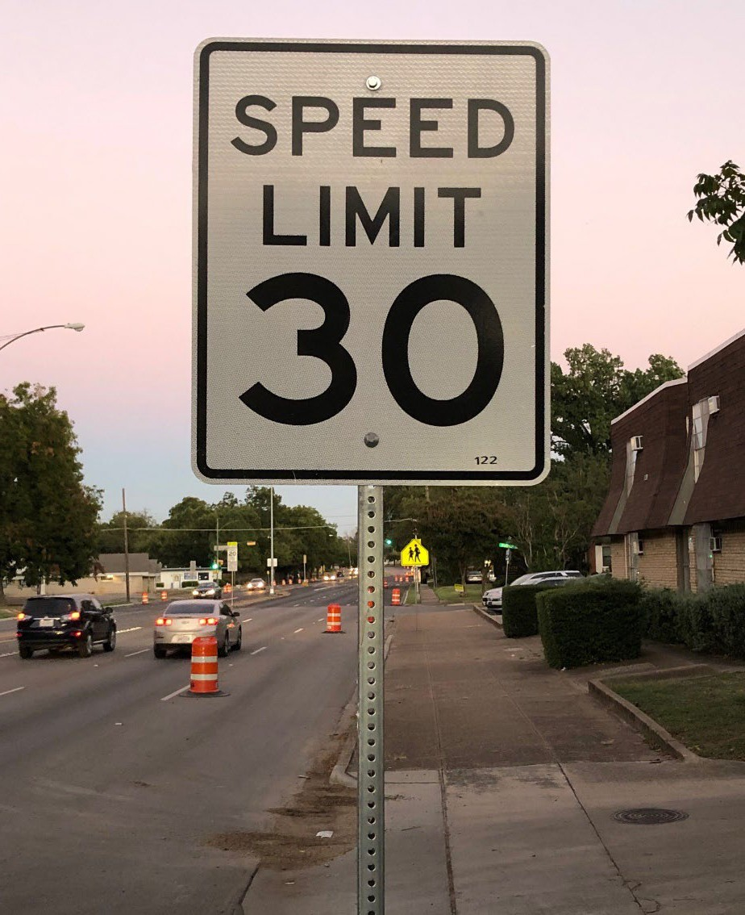
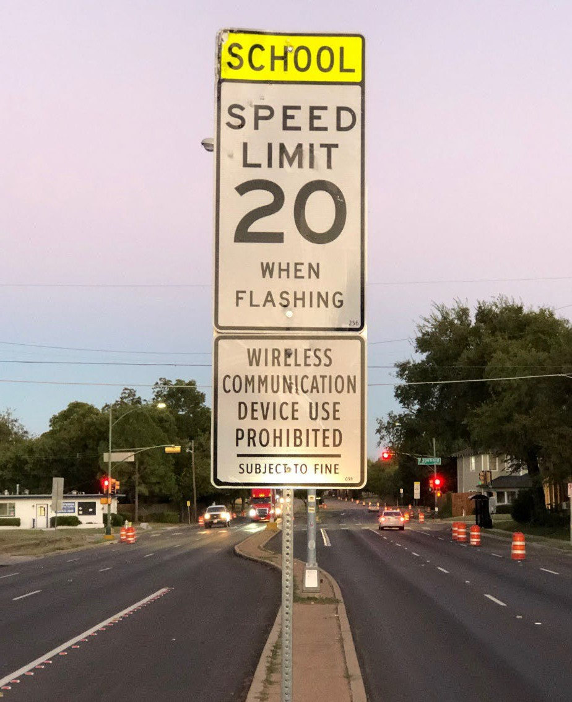
Speed Limit on Jefferson Boulevard
Posted speed of 30 MPH
Except for two school zones, with 20 MPH

Slide 24
Traffic Study by City of Dallas

Slide 25
A presentation was made on JAN 20 to board members from each neighborhoods that will be affected by any changes – Sunset Hill, L. O. Daniel, and Winnetka Heights.
Highlights from the Lane - Reduction Study included the following:
- Rate of accidents reduced by 82%
- Speeding on weekdays (vehicles traveling over 45 MPH) was reduced at a rate of 35% to 82%, depending on location.
The Task Force recommended a 2-Phased approach to traffic calming, with Phase 1 including making the lane reduction permanent by striping the far right lanes.
Striping scheduled for May 2022. Phase 2 may include bike lanes or curb extensions, and will include protected pedestrian crossings
Progress
thus far

Slide 26
Hampton Road (from Fort Worth Ave to Wright Street)
Clarendon Road (from Westmoreland to Zang)
Jefferson Blvd (west of Hampton Road)
Sylvan/Kessler Parkway (Coombs Creek Trail crossing)
Other Areas in Review

Slide 27
Pedestrian Refuge Islands

Slide 28
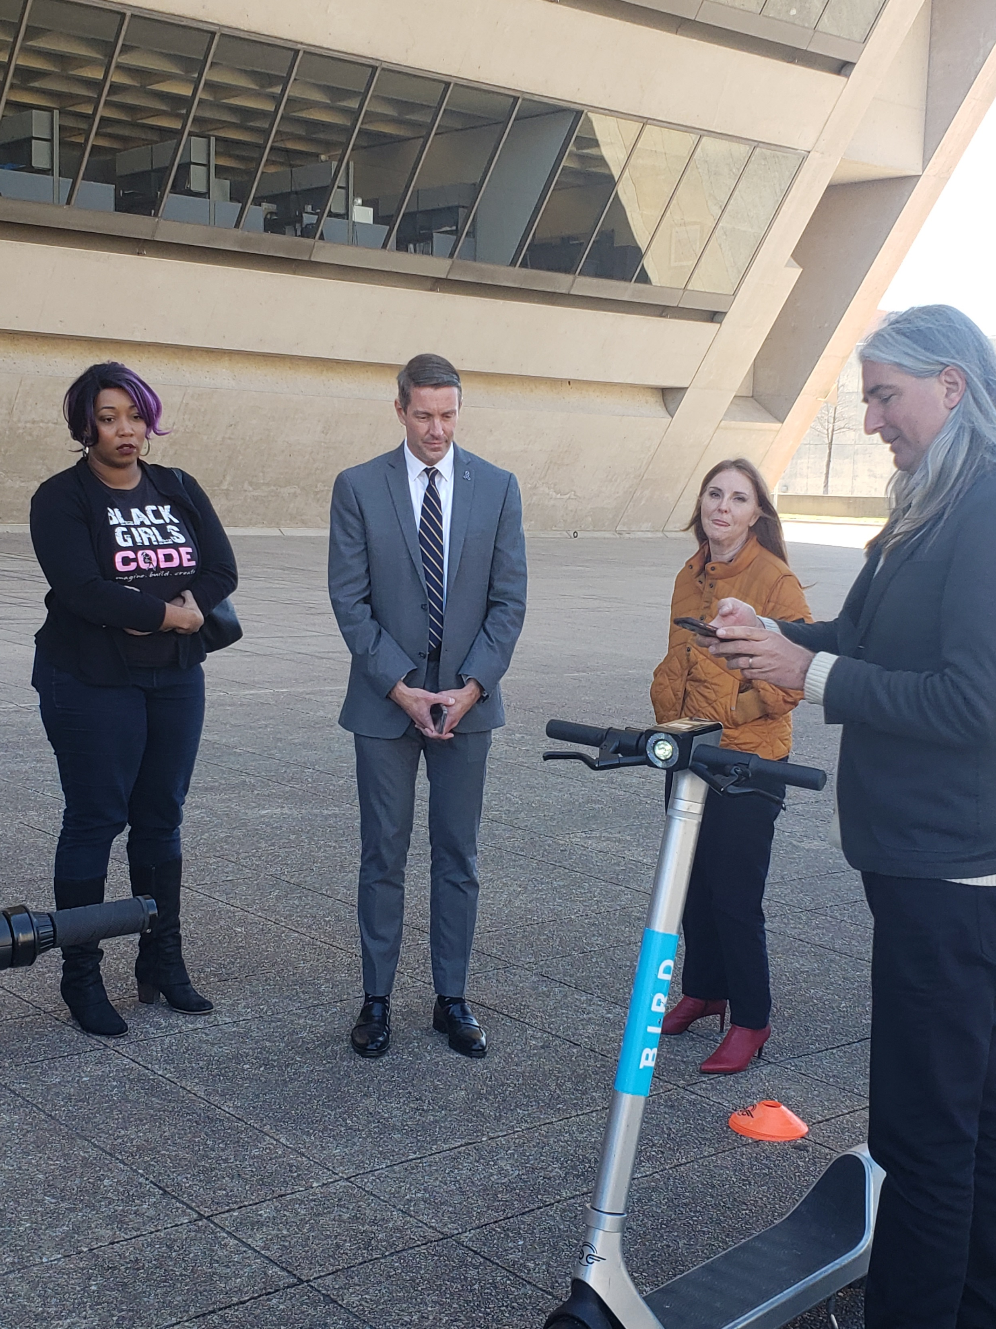
Cell: (214) 406-7861
District Office: (214) 671-8917
Email: chad.west@dallascityhall.com
fb.com/DallasDistrict1

