Slide 1
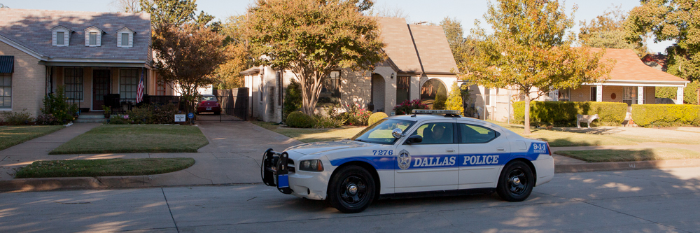

North Oak Cliff United Police Patrol
NOCUPP
Notes:
Through out this presentation, we will use the term NOCUPP to refer to this organization. NOCUPP stands for the North Oak Cliff United Police Patrol.

Slide 2
Crime Rates in Dallas & NOCUPP
NOCUPP : Delivering 53,000+ hours of Police Patrol

Slide 3
Crime in Dallas vs other Major TX Cities
Average Crime Rates 2015-2019 from FBI Data
  2020 data available, but report covers different crimes
Houston & San Antonio have significantly higher crime than Dallas & Austin
US Cities ranked by population:
  #4 Houston
  #7 San Antonio
  #9 Dallas
  #10 Austin
NOCUPP: Delivering 50,000+ hours of Police Patrol
Notes:
Amount spent by city per resident:
- Dallas and Houston spend about the same
San Antonio spends about 20% less
Austin spends about 20% more
US City Rankings by populations:
4 – Houston
7 – San Antonio
9 – Dallas
10 – Austin
Dallas does well – similar crime as the smaller Austin at 20% less per capita cost

Slide 4
Factors affecting Crime in Dallas vs other Major TX Cities
Large Populations attract Crime
Houston is too big
City per capita Spending
San Antonio spends too little
Dallas and Austin do best on crime, but Dallas does it at 20% less cost
NOCUPP: Delivering 50,000+ hours of Police Patrol
Notes:
Amount spent by city per resident:
- Dallas and Houston spend about the same
San Antonio spends about 20% less
Austin spends about 20% more
US City Rankings by populations:
4 – Houston
7 – San Antonio
9 – Dallas
10 – Austin
Dallas does well – similar crime as the smaller Austin at 20% less per capita cost

Slide 5
Serious Crime Rate in Dallas and NOCUPP Neighborhoods
NOCUPP Compliments and Augments DPD protection
Average crime in NOCUPP neighborhoods is 25% less than Dallas
2017-2019 Dallas data from FBI
2020 and 2021 Dallas data from DPD
NOCUPP : Delivering 60,000+ Vacation Watches
Notes:
Here’s how NOCUPP is doing.
These are the rates of combined serous crime rates tracked by the FBI in all of our NOCUPP neighborhoods versus the rates for all of Dallas from 2017 to 2021. The numbers for Dallas came from the FBI, those for NOCUPP came from the DPD Offense Incident Records.
We do about 30% better than the city average. (I did a similar plot of Residential crime there we are about 40% better.)
We all love living in North Oak Cliff, but some of the factors that make this the area that we love adversely affect crime.
People from all over the city come and sometimes overdo in our entertainment areas
Bishop Arts Entertainment borders Kidd Springs
Davis Street Entertainment in Winnetka Heights and borders Kings Highway
We border a number of badly aging apartment complexes on/off Plymouth and Atlantic
North Oak Cliff is an area where are more willing to Coexist with the unfortunate than people living in areas like North Dallas.
- Sherry’s Place in Kidd Springs
- Miramar Hotel
- Cliff Manor
- The Well Community

Slide 6
NOCUPP Impact on Dallas Neighborhoods
~20% drop in Kidd Springs crime since joining NOCUPP in 2017
Before joining NOCUPP
After joining NOCUPP
NOCUPP : Delivering Proactive Crime Prevention
Notes:
This slide shows the effect of NOCUPP membership on the rate of crime in a neighborhood.
Kidd Springs is the most recent neighborhood to join NOCUPP. They joined in 2017. This is a plot of the Major Crimes followed by the FBI –
Murder - Homicide/Non-Negligent Manslaughter
Aggravated Assault
Robbery
Larceny/Theft
Burglary
Motor Vehicle Theft
Arson
The FBI also tracks Rape. I’m happy to say that there hasn’t been an incident report about a rape in our neigborhoods since 2014.
As you can see, a rapid drop in crime happened when Kidd Springs joined. The drop in crime was actually better than 20%.

Slide 7
NOCUPP Impact in long term Neighborhoods
~40% drop in crime
Data from neighborhoods part of NOCUPP 2012 and beyond:
  Kessler Park
  Winnetka Heights
  Kessler Plaza
  Stevens Park Village
  West Kessler
  East Kessler
NOCUPP : Delivering an average to 13.7 hours of Patrol per day
Notes:
Here’s the long-term effect of all of our patrols over time.
These are crimes from 2012-2020 in the neighborhoods that were part of NOCUPP in 2012. The newest neighborhood to NOCUPP here is East Kessler, which joined in 2010.
We’ve plotted Crimes –
Larceny/Theft
Burglary
Motor Vehicle Theft
Vandalism
Aggravated Assault
As you can see the crime in these neighborhoods decreased about 40% from 2012 to 2020

Slide 8
Who, What, Why
&
Where
NOCUPP : Delivering Faster Responses to Calls for Help

Slide 9
Who is NOCUPP?
NOCUPP was established in 2007. We are a 501©(4) non-profit, volunteer-led organization committed to making North Oak Cliff safe for our families, neighbors and friends.
NOCUPP : Delivering 53,000+ hours of Police Patrol
Notes:
NOCUPP has been working to promote safety in Oak Cliff for 14 years.
We are a 501@(4) non-profit organization.
The members of the board are all volunteers – {introduce board members – Names – Neighborhood, anything they want to say}

Slide 10
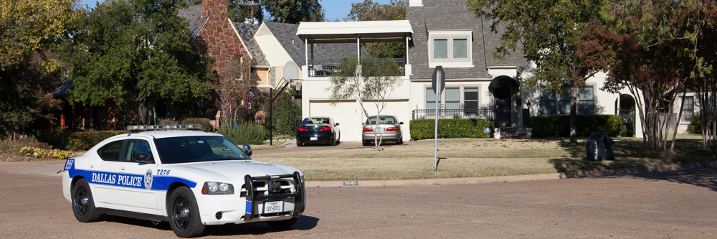
What does NOCUPP do?
Dallas Police Department
Expanded Neighborhood Patrol (ENP) Program
    Off-duty Dallas Police officers
    Marked Dallas Police car
    Patrol our member neighborhoods
    Current membership funds ~14 hours of patrol/day
Dedicated protection
NOCUPP: More members means more Police Patrol
Notes:
NOCUPP accomplishs its goals by operating one of DPD’s Expanded Neighborhood Patrol Programs.
Introduce Shawn here.
The ENP program allows neighborhood organizations to:
leases a squad car from the Dallas Police Department
The car is equipped with DPD radio, computer, etc
Contracts with 16 police officers to work off-duty shifts patrolling the NOCUPP area.
Officers are in uniform and armed. They have the same rights and responsibilities as when on duty.

Slide 11
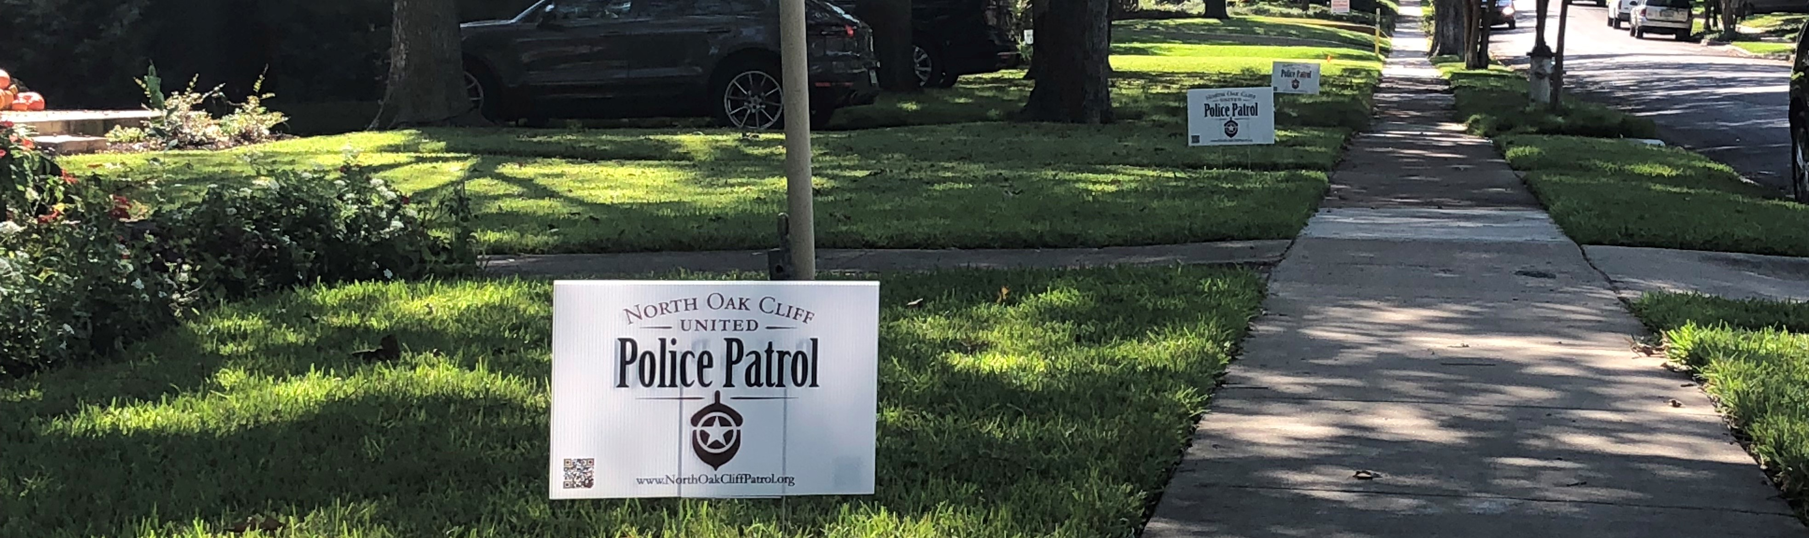
What NOCUPP does for Members
Benefits for Subscribers:
Direct access to officers
Suspicious person/bump in the night response
Vacation Watch & Construction Watch
Home Security Assessment by a NOCUPP Officer
Crime Reporting and Investigation Support
more members = more signs
= more concentrated area patrol
= safer neighborhoods
NOCUPP : Delivering 60,000+ Vacation Watches
Notes:
Everyone benefits by the presence of NOCUPP officers. However, there are some benefits that are exclusively for members.
Members receive the cell phone number of the patrol officers. This number can be used to call for help, report suspicious people or vehicles, request help in filing a police report.
NOCUPP can respond to alarms. DPD will issue a citation for false alarms; NOCUPP will not, regardless of the number of false alarms.
NOCUPP officers will check the doors, windows, and perimeter of a member’s homes while on vacation or away on business.
Every new member who signs up adds 10 more hours of patrol, make our neighborhood that much safer.

Slide 12

Why Police Patrol?
Proactive measure to fight crime
Faster response to calls for help
Complements Dallas Police Department & neighborhood Crime Watch programs
Proven deterrent to crime
NOCUPP : Delivering 53,000+ hours of Police Patrol
Notes:
NOCUPP is a proactive approach to fighting crime. Officers get to know who belongs in a neighborhood, and who doesn’t, and act to get criminals out of the neighborhood.
While on duty, NOCUPP officers can generally respond more quickly to calls for service than regular DPD officers. They are already here.
Expanded neighborhood patrol doesn’t replace DPD – it adds to it. It complements crime watch by providing faster response to crimes in progress..
The added police presence has been an effective deterrent to crime. When the DPD sees an uptick in crime in an area, they pull patrols from other sections of the city and concentrate them in the problem area. This brings the crime rate down rapidly.

Slide 13
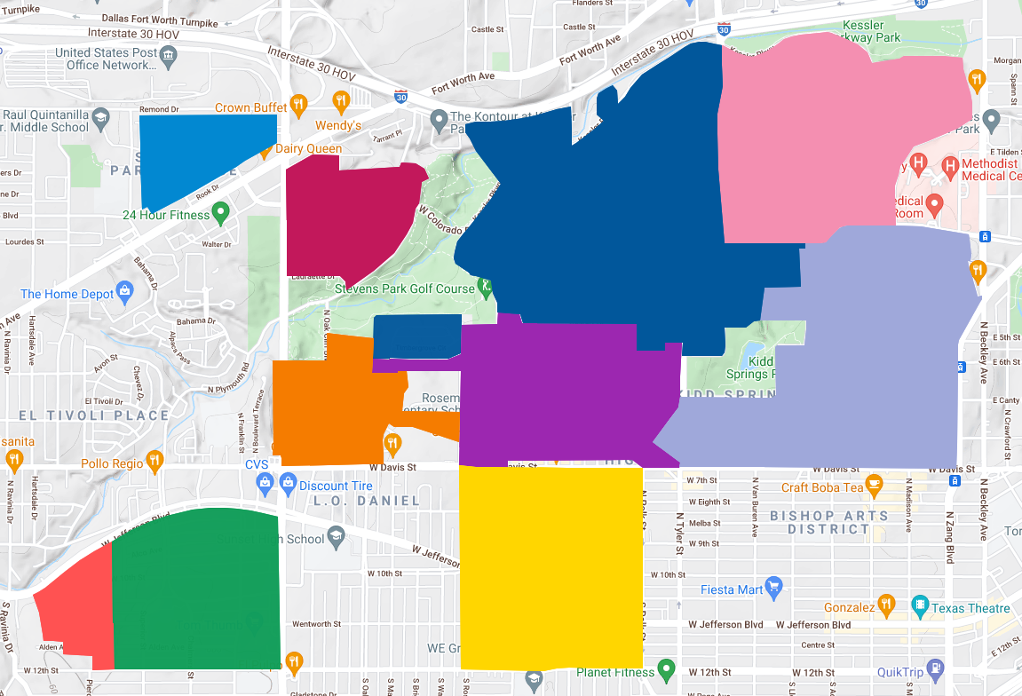
NOCUPP Neighborhoods
Stevens
Park
Village
East
Kessler
Stevens
Park
Estates
Kessler
Park
United
Kessler
Park
United
West
Kessler
Kings
Highway
Kidd
Springs
Winnetka
Heights
Kessler
Plaza
Ravinia
Heights
NOCUPP : Delivering Proactive Crime Prevention
Notes:
That’s a lot of neighborhoods. This map shows the neighborhoods that we have today. As you can see, our separate neighborhoods connect into a single large swath of Oak Cliff with significant swath of parks and golf course.

Slide 14
How
You Can Help
NOCUPP : Delivering 53,000+ hours of Police Patrol

Slide 15
How does it work?
Members
Provide
Resources
through
Membership
Dues to
Patrol Fund
More subscribers = more hours of patrol
NOCUPP : Delivering Uniformed DPD officers in DPD patrol cars
Notes:
Neighbor’s contributions are used to pay for police patrol within their own neighborhoods. We keep our expenses down as much as possible to maximize those patrols.
Nearly 90% of the voluntary contributions are used to pay for Police to patrol our neighborhoods.
Half of the other funds are used to pay to rent the Police car from the DPD
Half of the remaining funds go to printing the yard signs for our member’s yards.
PayPal – is the biggest remaining expense.

Slide 16
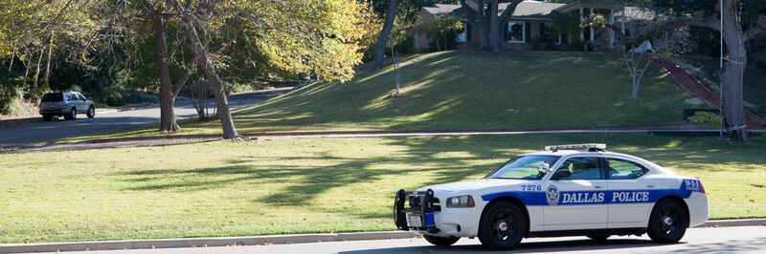
How to join?
NOCUPP area residents – 2 Options
Option 1: Mail property form & payment
Option 2: Sign up via website using PayPal
  www.nocupp.org
  We now offer Automatic Renewal
$182.50 for 6 months / $365 annual/ $365 for 1 year
NOCUPP : Delivering 60,000+ Vacation Watches

Slide 17





Thanks to our Sponsors & Partners!
NOCUPP : Delivering Uniformed DPD officers in DPD patrol cars

Slide 18
Into the Future!
NOCUPP : Delivering Faster Responses to Calls for Help

Slide 19
Where does NOCUPP go from here?
• NOCUPP remains committed to its primary function; the reduction of crime in the neighborhoods served by NOCUPP and the provision of services to our supporting membership.
• NOCUPP is committed to increasing its membership and the number of patrol hours performed by off-duty Dallas Police officers.
• NOCUPP will explore other ways to make North Oak Cliff neighborhoods safer; by supporting efforts to curb street racing and the installation of CCTV cameras in areas of higher crime (generally commercial areas which have crime bleed off into neighborhoods).
• Advocating for staffing levels at DPD and other essential services (such as 911) to insure safe neighborhoods.
NOCUPP : Committed to making North Oak Cliff a safer Community

Slide 20
More about NOCUPP
NOCUPP : Delivering Faster Responses to Calls for Help

Slide 21
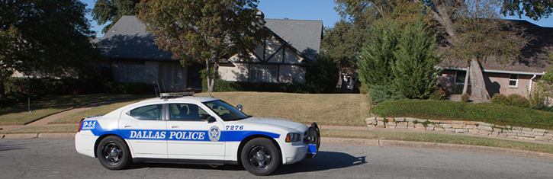
Current Patrol
Patrol schedule varies from week to week
  Nights
  Days
  Weekdays
  Weekends
13.7 hours/day of Patrol this year
Long Term Goal:
24 / 7 / 365
NOCUPP : Delivering 53,000+ hours of Police Patrol
Notes:
Currently we have enough contributions to support 100 hours of patrol per week. There are 168 hours in a week, so we’re approximately 60% of the way to our goal of continuous patrol.
Our patrol hours are scheduled to maximize patrols during peak crime hours. This is when most burglaries occur.
In the past, our patrols have been mostly during the day. But we had too many break ins to cars this Spring. So we hired some officers to patrol at night.

Slide 22
2020 Crime by Time of Day in Dallas and Texas
Separate graphs for Violent and Property crime are similar
Likelihood of early morning crime higher in Dallas
Last data point is crime with no associated time
Hour in Military Time
NOCUPP : Delivering 53,000+ hours of Police Patrol
Notes:
Here’s how NOCUPP is doing.
These are the rates of combined serous crime rates tracked by the FBI in all of our NOCUPP neighborhoods versus the rates for all of Dallas from 2017 to 2019. The numbers for Dallas came from the FBI, those for NOCUPP came from the DPD Offense Incident Records.
We do about 30% better than the city average. (I did a similar plot of Residential crime there we are about 40% better.)
We all love living in North Oak Cliff, but some of the factors that make this the area that we love adversely affect crime.
People from all over the city come and sometimes overdo in our entertainment areas
Bishop Arts Entertainment borders Kidd Springs
Davis Street Entertainment in Winnetka Heights and borders Kings Highway
We border a number of badly aging apartment complexes on/off Plymouth and Atlantic
North Oak Cliff is an area where are more willing to Coexist with the unfortunate than people living in areas like North Dallas.
- Sherry’s Place in Kidd Springs
- Miramar Hotel
- Cliff Manor
- The Well Community

Slide 23
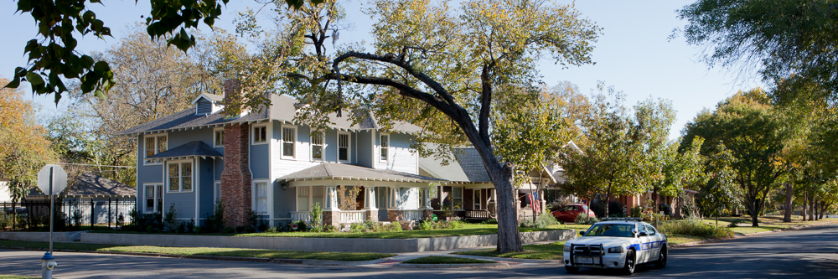
NOCUPP Activities
Category | Cumulative
Patrol Hours | 53,000+
Calls for Service | 12,400+
Traffic Stops | 3,600+
Citations | 1,320+
Arrests | 770+
Vacation Watches | 60,000+
NOCUPP : Delivering 53,000+ hours of Police Patrol
Notes:
Since the program started, NOCUPP has provided over 50,000 hours of patrol to our neighborhoods. To act as a deterrent to crime.
NOCUPP officers have arrested over 770 criminals in the NOCUPP area. These are individuals with rap sheets for drug trafficking, burglary, auto theft, aggravated assault, aggravated robbery, and even murder.
NOCUPP officers have issued over 1308 citations to criminals for violations. Note that NOCUPP is not issuing citations to law-abiding citizens. Their focus is on criminals with no valid reason to be in our neighborhoods.
NOCUPP has stopped more than 3600 suspicious vehicles. This results in an arrest or citation the majority of the time. Generally, in these cases, officers find illegal drugs or weapons in the vehicle, or discover that the occupant has a warrant for their arrest.
NOCUPP officers have responded to over 12,000 calls for service and provided vacation watch service more than 56,000 times.
The bottom line is that NOCUPP officers are actively working to identify criminals and neutralize them before they commit crimes, and the stats show that they are effective.

Slide 24
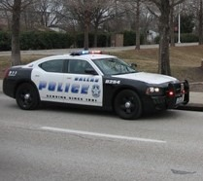
Experienced & Reliable
Officer On-Duty Capacity
Public Information Office
Neighborhood Police
Patrol
Auto Theft
Property Crime Investigation
Burglary Task Force
Narcotics
Crimes Against Persons
Domestic Violence
Undercover Surveillance
10 Officers
Average 13+ years
on the force
NOCUPP : Committed to making North Oak Cliff a safer Community
Notes:
There are currently 10 officers patrolling for NOCUPP. The average tenure on the force is over 10 years. They have experience in many different areas, so when a particular problem comes up, there is sure to be an officer with the expertise to address the problem. For example, a few years ago, auto theft was on the rise. A NOCUPP officer worked in his on-duty capacity in the Auto Theft division to get a “bait car” deployed in our area. DPD was able to catch the thieves and auto theft went down.

Slide 25
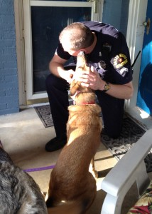
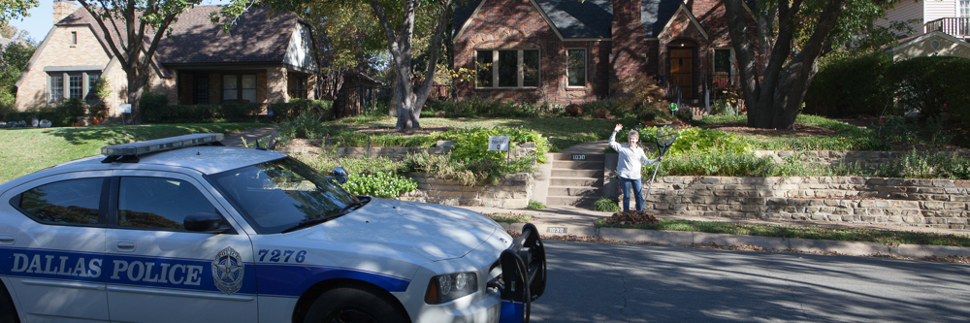
Why support NOCUPP?
Benefits for Subscribers: Personalized Service
NOCUPP Officers:
  Know our neighborhoods
  Know our neighbors
  Provide answers to questions
    What to do when ???
    How to make your house safer
NOCUPP : Delivering an average to 13.7 hours of Patrol per day
Notes:
Everyone benefits by the presence of NOCUPP officers. However, there are some benefits that are exclusively for members.
Members receive the cell phone number of the patrol officers. This number can be used to call for help, report suspicious people or vehicles, request help in filing a police report.
NOCUPP can respond to alarms. DPD will issue a citation for false alarms; NOCUPP will not, regardless of the number of false alarms.
NOCUPP officers will check the doors, windows, and perimeter of a member’s homes while on vacation or away on business.
Every new member who signs up adds 10 more hours of patrol, make our neighborhood that much safer.

Slide 26
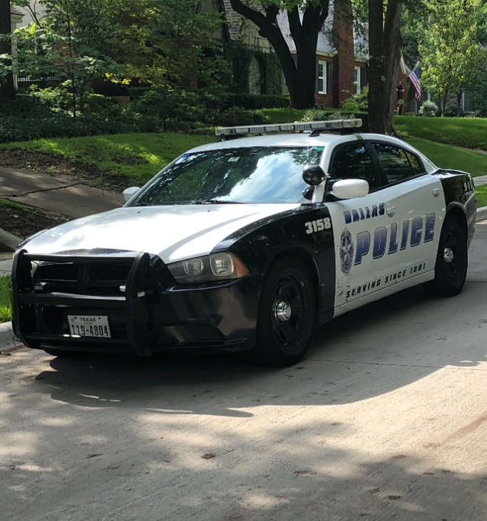
NOCUPP Impact on Everyone
NOCUPP officers currently patrol in car number 3158
*to April 1, 2022
NOCUPP : Delivering 53,000+ hours of Police Patrol
Notes:
NOCUPP members has been steadily growing over our lifetime. Which has allowed us to increase Police Patrol hours.
We are currently on-track to break our record for most patrol hours this year.
As you can see, we’ve recently achieved 50,000 patrol hours.
NOCUPP is the only ENP with a dedicated patrol car. We sometimes you other cars – when the car is being serviced, or in times when a second car is required, because of multiple patrols.
Our cars patrol every street in our neighborhoods on every shift. When you see a car slowly patrolling your neighborhood – it’s one of ours. The DPD doesn’t have time for this. The officers are too busy responding to calls.
‘

Slide 27
NOCUPP Impact for Members Only
“Thank you for the vacation watch last week. I appreciate your valuable service. Makes me feel much safer coming home to an empty house after having been gone for a week. (I once surprised a burglar inside my house after coming home from vacay. It was quite scary.)”
*to April 1, 2022
NOCUPP : Delivering 53,000+ hours of Police Patrol
Notes:
Vacation Watches are an extremely popular program. Members text or call the officer cell phone and let them know who they are, where they live, and the dates when they will be away. Sometimes I’ve done it from the airport. The officers stop by the homes to look for signs of trouble. They call the owners cell phone about anything suspicious, or if there’s something like package that might need to be hidden.
The service fits well into the police patrol. The officers are visible when they do this. And this allows them to get out of the car and talk to people in the neighborhood.
This is a service that the DPD would be providing if the had the man power.
In 2016, the DPD offered an option to call 311 to report a vacation watch directly to the police. The program was discontinued because the regular duty officers don’t have time to perform this service.
The testimonial that you see came in this summer. This member once surprised a burglar inside her home. I can only imagine how awful that was. Before I joined NOCUPP, I came home one day to find that my front door had been kicked in.

Slide 28
Vacation Watches for an Average Year
Summer
Holidays
Spring Break
NOCUPP : Delivering 60,000+ Vacation Watches
Notes:
This graph comes from the cumulative monthly Vacation watch numbers from 2008 to 2019. 2020 was nuts.
We have seen a lot of vacation watches since people were vaccinated this year. In August, we set a record for most vacation watches.
Some people leave town for Spring Break.
Many people leave for the Winter holidays.
But escaping the heat in the Summer is the peak travel time for our Members.

Slide 29
NOCUPP Expansion
Milestones in expansion into Neighborhoods
Oct 2007 ENP signed
Feb 2008 Winnetka Heights
2009 Kessler Plaza, Stevens Park Village & West Kessler
2010 East Kessler
2013 Stevens Park Estates
2015 Ravinia Heights
2016 Kings Highway
2017 Kidd Springs
2019 High Grove in West Kessler
Nov 2007 Kessler Park
United
NOCUPP : Delivering Faster Responses to Calls for Help
Notes:
Our single organization is focused on crime prevention neighborhoods.
This slide shows how have grown.
We joined the DPD’s Expanded Neighborhood Patrol program in October of 2007.
We started patrols in Kessler Park United a month later.
Three months later we expanded to Winnetka Heights.
A year later, Kessler Plaza, Stevens Park Village and West Kessler joined NOCUPP.
A year after that East Kessler joined.
In 2012, Stevens Park Estates was welcomed into the NOCUPP family.
In 2015, the Eastern section of Ravinia Heights – Mostly Brisco Blvd joined.
A year later, Kings Highway joined.
Our latest neighborhood to join came in a year later in 2017.
Our latest addition was in 2019 when the High Grove development was brought into West Kessler.

Slide 30







Thanks to our Neighborhood Associations!
Kessler Plaza –
Ravinia Heights
Neighborhood Association
NOCUPP : Delivering 53,000+ hours of Police Patrol
Notes:
Our 10 neighborhoods are served by 9 neighborhood association. Kessler Plaza/Ravinia Heights are served by a merged association.
NOCUPP partners with the organizations as much as possible. We Organize along the lines of the associates with a representative who supports the members of each.

